Slide 1
Basic Laws
Ohm's Law
Kirchhoff's Laws

Slide 2
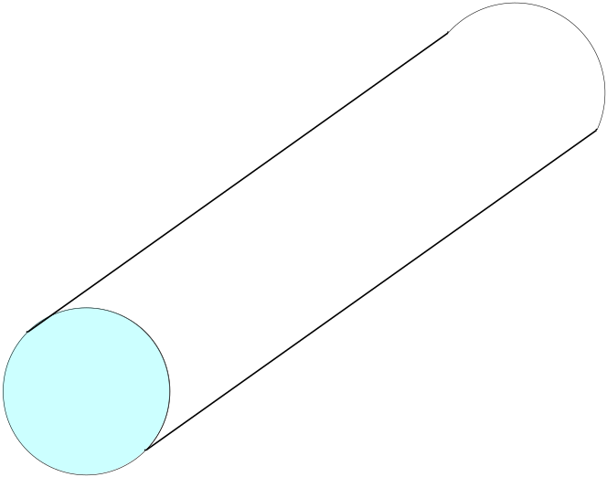
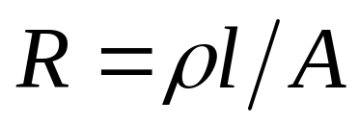
Resistance
ρ = resistivity in Ohm-meters
Resistance
l
= length
Good conductors (low ρ): Copper, Gold
A
Good insulators (high ρ): Glass, Paper

Slide 3
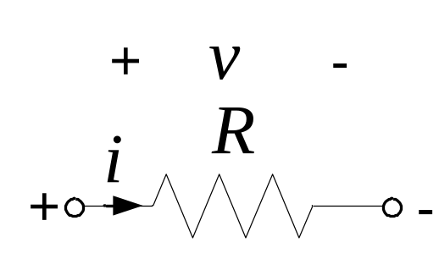
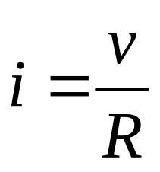
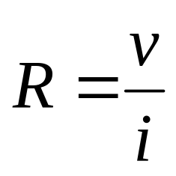
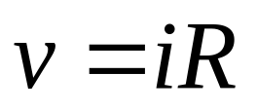
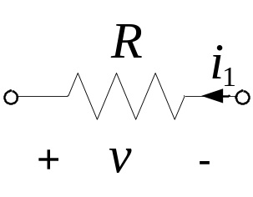
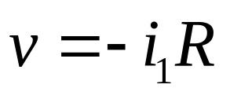
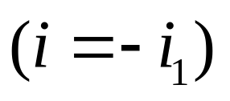

Ohm's Law
Units of resistance, R, is Ohms (Ω)
R = 0: short circuit
open circuit

Slide 4
Ohm’s Law
v(t) = i(t) R - or - V = I R
p(t) = i²(t) R = v²(t)/R [+ (absorbing)]
i(t)
The Rest of the Circuit
+
R
v(t)
–
ECE201 Lect-2

Slide 5
Example: a 25W Bulb
If the voltage across a 25W bulb is 120V, what is its resistance?
R = V²/P = (120V)²/25W = 576 Ω
What is the current flowing through the 25W bulb?
I = V/R = 120V/576 Ω = 0.208 A
ECE201 Lect-2

Slide 6
Open Circuit
What if R=∞?
i(t) = v(t)/R = 0
i(t)=0
The Rest of the Circuit
+
v(t)
–
ECE201 Lect-2

Slide 7
Short Circuit
What if R=0?
v(t) = R i(t) = 0
i(t)
The Rest of the Circuit
+
v(t)=0
–
ECE201 Lect-2

Slide 8


Conductance
Conductance may refer to:
Electrical conductance, the ability for electricity to flow a certain path
Fluid conductance, the ability for fluid to transmit through materials
Thermal conductivity, the ability for temperatures to transmit through materials
Conductance (graph), a measure in graph theory
Conductance is measured in Siemens (usually abbreviated S) and, in formulae, is represented by the letter G.

Slide 9
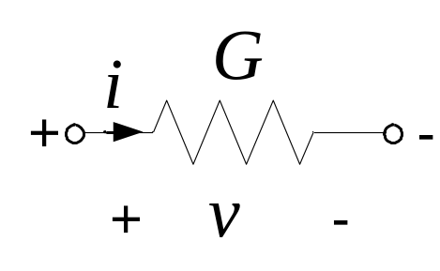
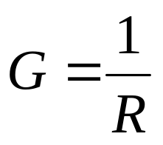
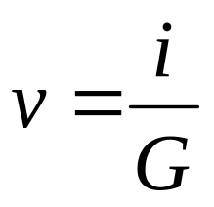
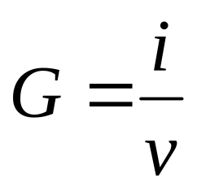
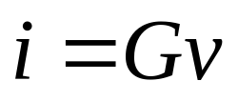
Conductance, G
Unit of G is siemens (S),
1 S = 1 A/V

Slide 10
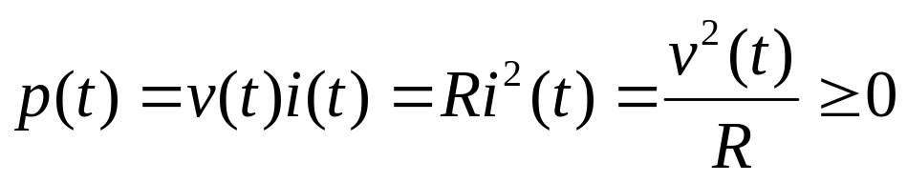
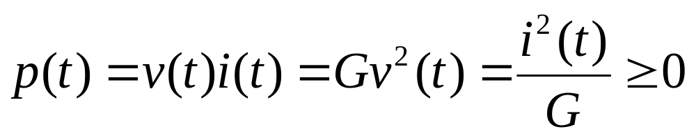
Power
A resistor always dissipates energy; it transforms electrical energy, and dissipates it in the form of heat.
Rate of energy dissipation is the instantaneous power

Slide 11
Basic Laws
Ohm's Law
Kirchhoff's Laws
Series Resistors and Voltage Division
Parallel Resistors and Current Division
Source Exchange

Slide 12
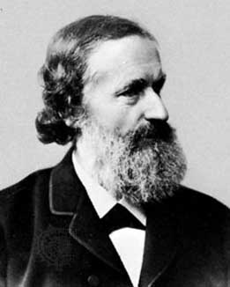
Gustav Robert Kirchhoff (1824 – 1887)
Born in Prussia (now Russia), Kirchhoff developed his "laws" while a student in 1845. These laws allowed him to calculate the voltages and currents in multiple loop circuits.
http://www-history.mcs.st-andrews.ac.uk/history/PictDisplay/Kirchhoff.html

Slide 13
CIRCUIT TOPOLOGY
Topology: How a circuit is laid out.
A branch represents a single circuit (network) element; that is, any two terminal element.
A node is the point of connection between two or more branches.
A loop is any closed path in a circuit (network).
A loop is said to be independent if it contains a branch which is not in any other loop.

Slide 14
Circuit Definitions
Node – any point where 2 or more circuit elements are connected together
  Wires usually have negligible resistance
  Each node has one voltage (w.r.t. ground)
Branch – a circuit element between two nodes
Loop – a collection of branches that form a closed path returning to the same node without going through any other nodes or branches twice

Slide 15
Example
How many nodes, branches & loops?
R₁
+
Vo
-
+
-
Vs
Is
R₂
R₃

Slide 16
Example
Three nodes
R₁
+
Vo
-
+
-
Vs
Is
R₂
R₃

Slide 17
Example
5 Branches
R₁
+
Vo
-
+
-
Vs
Is
R₂
R₃

Slide 18
Example
Three Loops, if starting at node A
A
B
R₁
+
Vo
-
+
-
Vs
Is
R₂
R₃
C

Slide 19
Kirchoff’s Voltage Law (KVL)
The algebraic sum of voltages around each loop is zero
  Beginning with one node, add voltages across each branch in the loop (if you encounter a + sign first) and subtract voltages (if you encounter a – sign first)
Σ voltage drops - Σ voltage rises = 0
Or Σ voltage drops = Σ voltage rises

Slide 20
Example
Kirchoff’s Voltage Law around 1st Loop
A
I₁
+ I₁R₁ -
B
R₁
I₂
+
Vo
-
+
I₂R₂
-
+
-
Vs
Is
R₂
R₃
C
Assign current variables and directions
Use Ohm’s law to assign voltages and polarities consistent with
passive devices (current enters at the + side)

Slide 21
Example
Kirchoff’s Voltage Law around 1st Loop
A
I₁
+ I₁R₁ -
B
R₁
I₂
+
Vo
-
+
I₂R₂
-
+
-
Vs
Is
R₂
R₃
C
Starting at node A, add the 1st voltage drop: + I₁R₁

Slide 22
Example
Kirchoff’s Voltage Law around 1st Loop
A
I₁
+ I₁R₁ -
B
R₁
I₂
+
Vo
-
+
I₂R₂
-
+
-
Vs
Is
R₂
R₃
C
Add the voltage drop from B to C through R₂: + I₁R₁ + I₂R₂

Slide 23
Example
Kirchoff’s Voltage Law around 1st Loop
A
I₁
+ I₁R₁ -
B
R₁
I₂
+
Vo
-
+
I₂R₂
-
+
-
Vs
Is
R₂
R₃
C
Subtract the voltage rise from C to A through Vs: + I₁R₁ + I₂R₂ – Vs = 0
Notice that the sign of each term matches the polarity encountered 1st

Slide 24
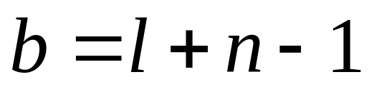
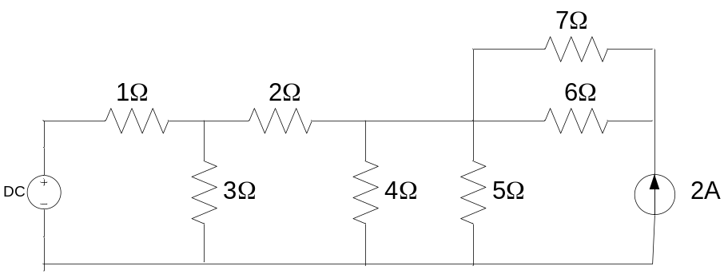
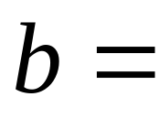
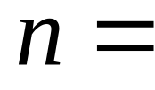
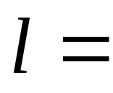
Fundamental Theorem of Network Topology
For a network with b branches, n nodes
and l independent loops:
Example
9
5
5

Slide 25
Kirchhoff’s Laws
Kirchhoff’s Current Law (KCL)
  sum of all currents entering a node is zero
  sum of currents entering node is equal to sum of currents leaving node
Kirchhoff’s Voltage Law (KVL)
  sum of voltages around any loop in a circuit is zero
ECE201 Lect-2

Slide 26
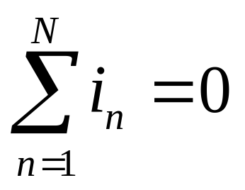
Kirchoff’s Current Law (KCL)
The algebraic sum of the currents entering a node (or a closed boundary) is zero.
where N = the number of branches connected to the node and i_{n} = the n^{th} current entering (leaving) the node.

Slide 27
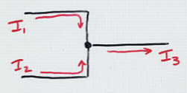
Kirchoff’s Current Law
At any junction point in an electrical circuit, the total current into the junction equals the total current out of the junction.
(“What goes in must come out.”)
In the diagram at right,
I₁ + I₂ = I₃

Slide 28





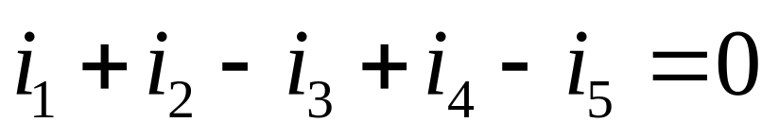
Sign convention: Currents entering the node are positive, currents leaving the node are negative.

Slide 29
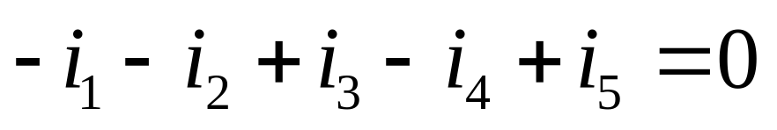
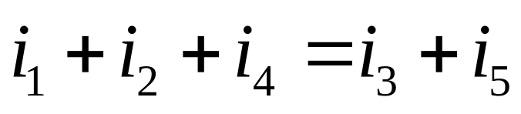
Kirchoff’s Current Law (KCL)
The algebraic sum of the currents entering (or leaving) a node is zero.
Entering:
Leaving:
The sum of the currents entering a node is equal to the sum of the currents leaving a node.

Slide 30
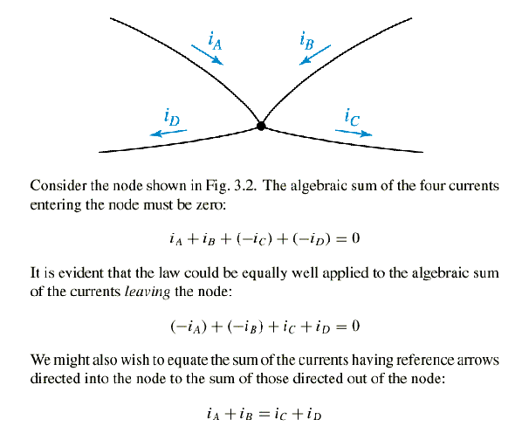

Slide 31
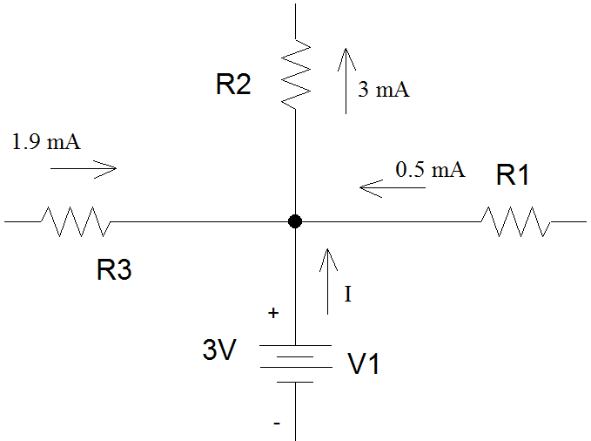
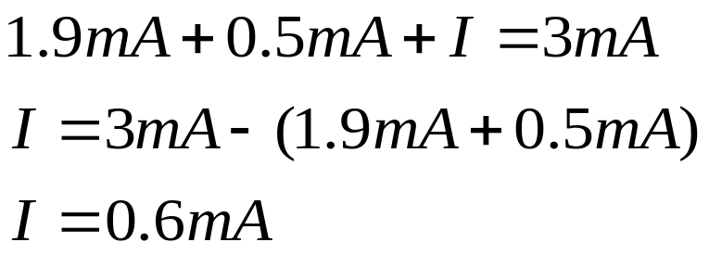
Example 1
Determine I, the current flowing out of the voltage source.
  Use KCL
    1.9 mA + 0.5 mA + I are
    entering the node.
    3 mA is leaving the node.
    V1 is generating power.

Slide 32
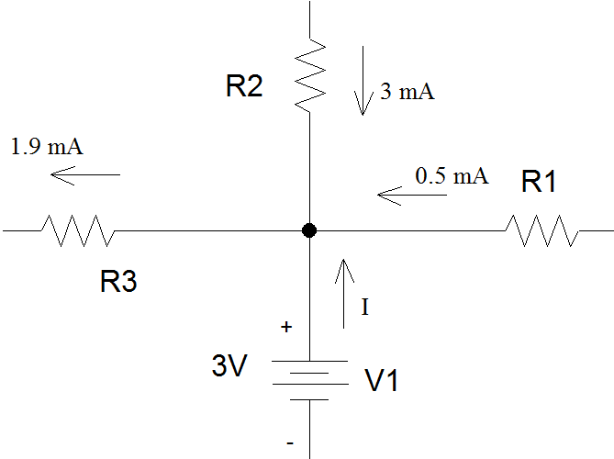
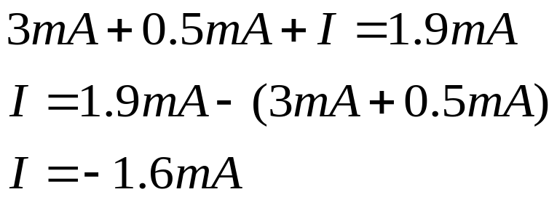
Example 2
Suppose the current through R2 was entering the node and the current through R3 was leaving the node.
  Use KCL
    3 mA + 0.5 mA + I are
    entering the node.
    1.9 mA is leaving the node.
    V1 is dissipating power.

Slide 33
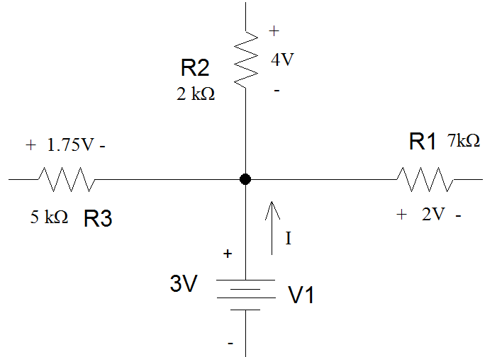
Example 3
If voltage drops are given instead of currents, you need to apply Ohm’s Law to determine the current flowing through each of the resistors before you can find the current flowing out of the voltage supply.

Slide 34
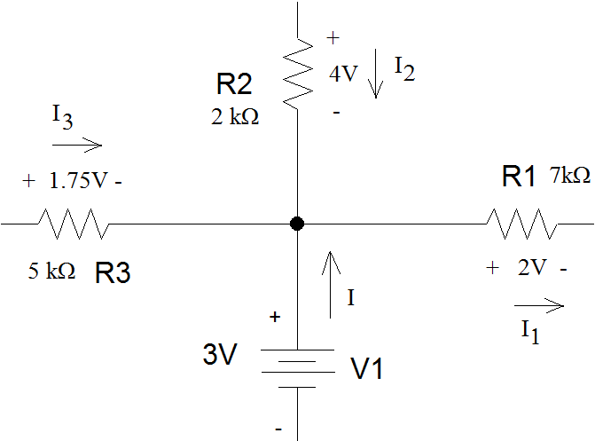
Example 3 (con’t)
For power dissipating components such as resistors, passive sign convention means that current flows into the resistor at the terminal has the + sign on the voltage drop and leaves out the terminal that has the – sign.

Slide 35
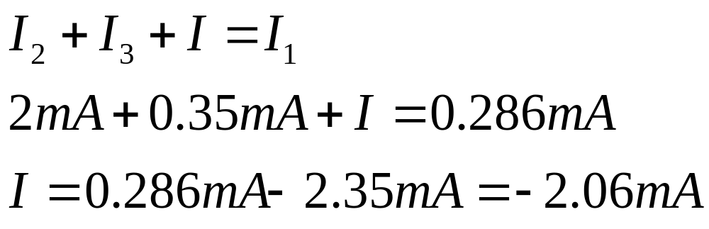
Example 3 (con’t)
I1 is leaving the node.
I2 is entering the node.
I3 is entering the node.
I is entering the node.``

Slide 36
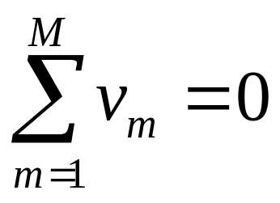
Kirchoff’s Voltage Law (KVL)
The algebraic sum of the voltages around any loop is zero.
where M = the number of voltages in the loop and v_{m} = the m^{th} voltage in the loop.

Slide 37
KVL Polarity
A loop is any closed path through a circuit in which no node is encountered more than once
Voltage Polarity Convention
  A voltage encountered + to - is positive
  A voltage encountered - to + is negative
ECE201 Lect-2

Slide 38
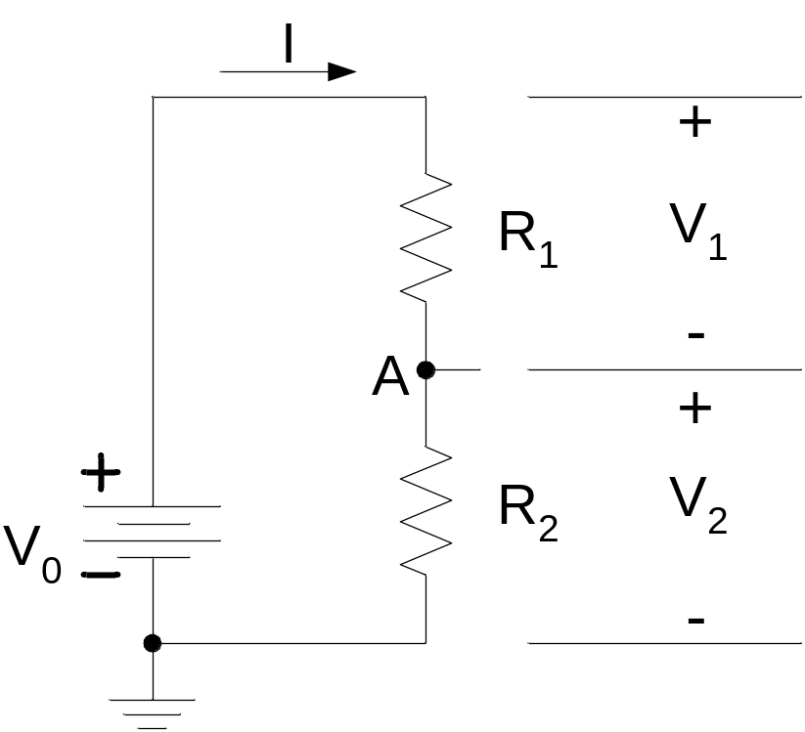
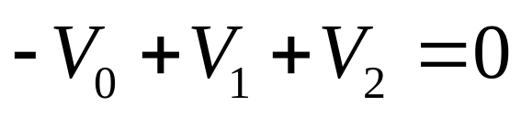
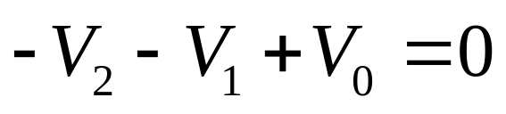
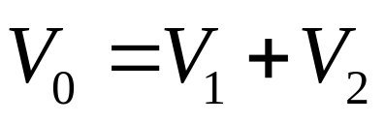
Sign convention: The sign of each voltage is the polarity of the terminal first encountered in traveling around the loop.
The direction of travel is arbitrary.
Clockwise:
Counter-clockwise:

Slide 39
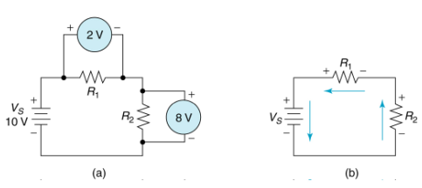
Kirchhoff’s Voltage Law,
Example:
V_{S} = +10V, V₁ = +2V, V₂ = +8V

Slide 40
Basic Laws of Circuits
Kirchhoff’s Voltage Law:
Consideration 1: Sum of the voltage drops around a circuit
equal zero. We first define a drop.
We assume a circuit of the following configuration. Notice that
no current has been assumed for this case, at this point.
_
v₂
+
+
+
v₁
v₄
_
_
_
v₃
+
Figure 3.1
2

Slide 41
Basic Laws of Circuits
Kirchhoff’s Voltage Law:
Consideration 1.
We define a voltage drop as positive if we enter the positive terminal
and leave the negative terminal.
+
v₁
_
Figure 3.2
The drop moving from left to right above is + v₁.
_
v₁
+
Figure 3.3
The drop moving from left to right above is – v₁.
3

Slide 42
Basic Laws of Circuits
Kirchhoff’s Voltage Law:
Consider the circuit of Figure 3.4 once
again. If we sum the voltage drops in the clockwise direction around the
circuit starting at point “a” we write:
- v₁ – v₂ + v₄ + v₃ = 0

drops in CW direction starting at “a”
_
v₂
+
+
+
v₁
v₄
_
_
“a”
•
_
v₃
+
Figure 3.4
- v₃ – v₄ + v₂ + v₁ = 0

drops in CCW direction starting at “a”
4

Slide 43
Basic Laws of Circuits
Kirchhoff’s Voltage Law:
Consideration 2: Sum of the voltage rises around a circuit
equal zero. We first define a drop.
We define a voltage rise in the following diagrams:
_
v₁
+
Figure 3.5
The voltage rise in moving from left to right above is + v₁.
+
v₁
_
Figure 3.6
The voltage rise in moving from left to right above is - v₁.
5

Slide 44
Basic Laws of Circuits
Kirchhoff’s Voltage Law:
Consider the circuit of Figure 3.7 once
again. If we sum the voltage rises in the clockwise direction around the
circuit starting at point “a” we write:
+ v₁ + v₂ - v₄ – v₃ = 0

rises in the CW direction starting at “a”
_
v₂
+
+
+
v₁
v₄
_
_
“a”
•
_
v₃
+
Figure 3.7
+ v₃ + v₄ – v₂ – v₁ = 0

rises in the CCW direction starting at “a”
6

Slide 45
Basic Laws of Circuits
Kirchhoff’s Voltage Law:
Consideration 3: Sum of the voltage rises around a circuit
equal the sum of the voltage drops.
Again consider the circuit of Figure 3.1 in which we start at
point “a” and move in the CW direction. As we cross elements
1 & 2 we use voltage rise: as we cross elements 4 & 3 we use
voltage drops. This gives the equation,
p
v₁ + v₂ = v₄ + v₃
_
v₂
+
+
2
+
v₁
v₄
1
3
_
_
_
4
7
v₃
+

Slide 46
Basic Laws of Circuits
Kirchhoff’s Voltage Law: Comments.
We note that a positive voltage drop = a negative voltage rise.
We note that a positive voltage rise = a negative voltage drop.
We do not need to dwell on the above tongue twisting statements.
There are similarities in the way we state Kirchhoff’s voltage
and Kirchhoff’s current laws: algebraic sums …
However, one would never say that the sum of the voltages
entering a junction point in a circuit equal to zero.
Likewise, one would never say that the sum of the currents
around a closed path in an electric circuit equal zero.
8

Slide 47
Basic Laws of Circuits
Kirchhoff’s Voltage Law: Further details.
For the circuit of Figure 3.8 there are a number of closed paths.
Three have been selected for discussion.
+
v₂
-
-
v₅
+
-
-
-
Path 1
v₁
v₄
v₆
+
+
+
Path 2
Figure 3.8
Multi-path
Circuit.
v₃
v₇
-
+
+
-
Path 3
+
-
+
v₁₂
v₁₀
v₈
+
-
-
+
v₁₁
-
-
v₉
+
9

Slide 48
Basic Laws of Circuits
Kirchhoff’s Voltage Law: Further details.
For any given circuit, there are a fixed number of closed paths
that can be taken in writing Kirchhoff’s voltage law and still
have linearly independent equations. We discuss this more, later.
Both the starting point and the direction in which we go around a closed
path in a circuit to write Kirchhoff’s voltage law are arbitrary. However,
one must end the path at the same point from which one started.
Conventionally, in most text, the sum of the voltage drops equal to zero is
normally used in applying Kirchhoff’s voltage law.
10

Slide 49
Basic Laws of Circuits
Kirchhoff’s Voltage Law: Illustration from Figure 3.8.
Using sum of the drops = 0
“b”
•
Blue path, starting at “a”
- v₇ + v₁₀ – v₉ + v₈ = 0
+
v₂
-
-
v₅
+
-
-
-
v₁
v₄
v₆
+
+
+
v₃
Red path, starting at “b”
+v₂ – v₅ – v₆ – v₈ + v₉ – v₁₁
– v₁₂ + v₁ = 0
-
+
+
v₇
-
•
“a”
+
-
+
v₁₂
v₁₀
v₈
+
Yellow path, starting at “b”
+ v₂ – v₅ – v₆ – v₇ + v₁₀ – v₁₁
- v₁₂ + v₁ = 0
-
-
+
v₁₁
-
-
v₉
+
11

Slide 50
Basic Laws of Circuits
Kirchhoff’s Voltage Law: Double subscript notation.
Voltages in circuits are often described using double subscript notation.
Consider the following:
•
•
a
b
Figure 3.9: Illustrating double subscript notation.
V_{ab} means the potential of point a with respect to point b with
point a assumed to be at the highest (+) potential and point b
at the lower (-) potential.
12

Slide 51
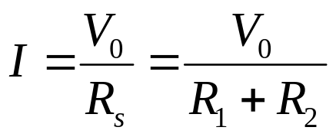
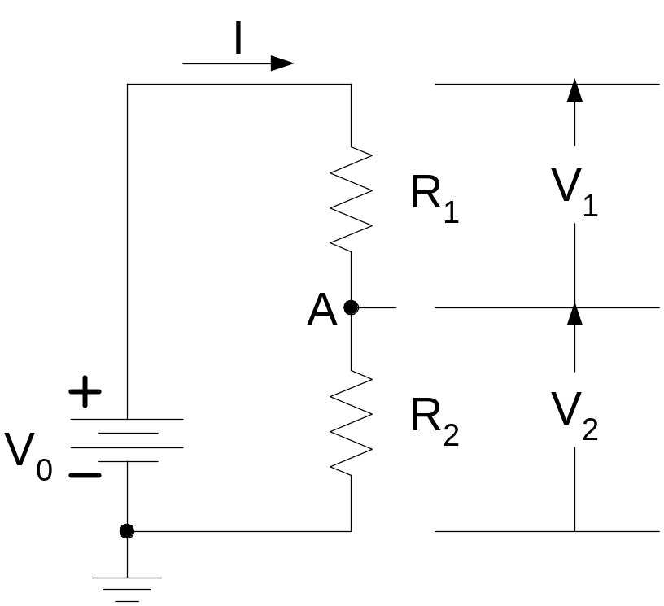
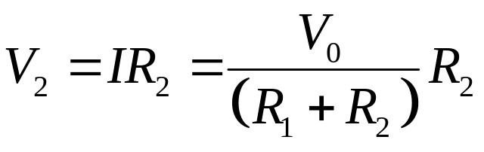
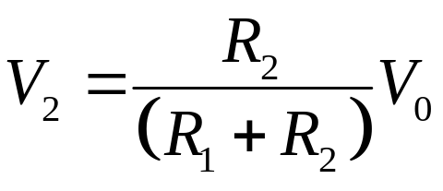
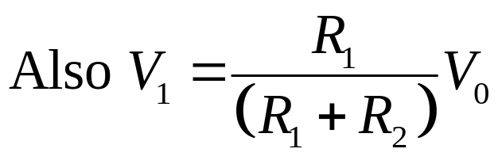
Voltage Divider Rule

Slide 52
When can the Voltage Divider Formula be Used?
I
I
R₁
R₁
+
–
+
–
R₂
V₂
R₂
V₂
V_{SS}
+
V_{SS}
+
−
R₃
−
R₃
R₄
R₄
R₅
R
R
V
2
⋅
V
V
2
⋅
V
2
=
SS
2
≠
SS
R
+
R
+
R
+
R
R
+
R
+
R
+
R
1
2
3
4
1
2
3
4
Correct, if nothing else
is connected to nodes
because R₅ removes condition
of resistors in series
EECS 42, Spring 2005
Week 2a

Slide 53
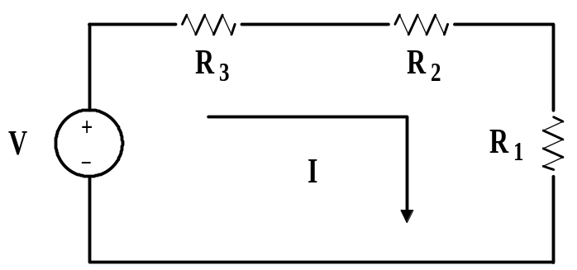
Basic Laws of Circuits
Kirchhoff’s Voltage Law: Single-loop circuits.
Example 3.1: For the circuit of Figure 3.14, the following is known:
R₁ = 4 ohms, R₂ = 11 ohms, V = 50 volts, P₁ = 16 watts
Find R_{3.}
Solution:
P₁ = 16 watts = I²R₁
, thus,
I = 2 amps
V = I(R₁ + R₂ + R₃), giving,
Figure 3.14: Circuit for example 3.1.
R₁ + R₂ + R₃ = 25, then solve for R₃,
R₃ = 25 – 15 = 10 ohms
18

Slide 54
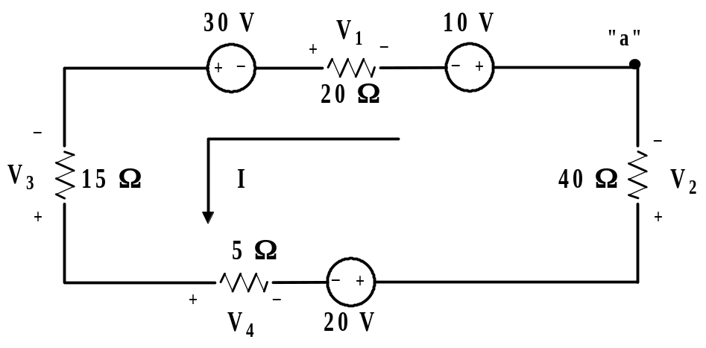
Basic Laws of Circuits
Kirchhoff’s Voltage Law: Single-loop circuits.
Example 3.2: For the circuit in Figure 3.15 find I, V₁, V₂, V₃, V₄ and the
power supplied by the 10 volt source.
Figure 3.15: Circuit for example 3.2.
For convenience, we start at point “a” and sum voltage drops =0 in the
direction of the current I.
+10 – V₁ – 30 – V₃ + V₄ – 20 + V₂ = 0 Eq. 3.1
19

Slide 55
Basic Laws of Circuits
Kirchhoff’s Voltage Law: Single-loop circuits. Ex. 3.2 cont.
We note that: V₁ = - 20I, V₂ = 40I, V₃ = - 15I, V₄ = 5I
We substitute the above into Eq. 3.1 to obtain Eq. 3.3 below.
10 + 20I – 30 + 15I + 5I – 20 + 40I = 0.
Solving this equation gives, I = 0.5 A.
Using this value of I in Eq. 3.2 gives;
V₁ = - 10 V
V₃ = - 7.5 V
V₂ = 20 V
V₄ = 2.5 V
P_{10(supplied)} = -10I = - 5 W
(We use the minus sign in –10I because the current is entering the + terminal)
In this case, power is being absorbed by the 10 volt supply.
20

